Slide 1
A1: Approval diversity (race)
A2: Approval diversity (muslims)
A3: Approval diversity (immigrants)
B: Not too many immigrants
C1: Expecting environmental catastrophe
C2: Nature not strong enough to cope
C3: Humans insure earth remains fit
D1: Empathy with Europeans
D2: Empathy with humankind
D3: Empathy with countrymen
D4: Empathy with people in neighborhood
D5: Empathy with immigrants
E: No membership in social organizations
F: Not only one true religion
G: Non-religious politicians are not unfit
H1: No confidence in armed forces
H2: Confidence in the education systems
H3: Confidence in the police
H4: Confidence in the parliament
H5: Confidence in the government
I: Not strongly proud of the country
J: No job priority for people from the country
K: Approval of open borders
L: Immigrants are not a strain on welfare
M: Immigrants do not take jobs away
N1: Confidence in the EU
N2: Confidence in the UN
O: Supra-national social group identity
P: No ancestry based citizenship ideal
Q: Immigrants do not undermine cultural life
R: Immigrants to not increase crime rates
S: Immigrants will not be a threat to society
T: No fear of loss of culture through the EU
FIGURE 1

Slide 2
Confidence in institutions
Opposition to protectionism Outgroup derogation
Social group identity Global environmental issues
Empathy Issues
Diversity Issues

Slide 3
A1: Approval diversity (race)
A2: Approval diversity (muslims)
A3: Approval diversity (immigrants)
B: Not too many immigrants
C1: Expecting environmental catastrophe
C2: Nature not strong enough to cope
C3: Humans insure earth remains fit
D1: Empathy with Europeans
D2: Empathy with humankind
D3: Empathy with countrymen
D4: Empathy with people in neighborhood
D5: Empathy with immigrants
E: No membership in social organizations
F: Not only one true religion
G: Non-religious politicians are not unfit
H1: No confidence in armed forces
H2: Confidence in the education systems
H3: Confidence in the police
H4: Confidence in the parliament
H5: Confidence in the government
I: Not strongly proud of the country
J: No job priority for people from the country
K: Approval of open borders
L: Immigrants are not a strain on welfare
M: Immigrants do not take jobs away
N1: Confidence in the EU
N2: Confidence in the UN
O: Supra-national social group identity
P: No ancestry based citizenship ideal
Q: Immigrants do not undermine cultural life
R: Immigrants to not increase crime rates
S: Immigrants will not be a threat to society
T: No fear of loss of culture through the EU
FIGURE 1

Slide 4
FIGURE 2
A)
Centrality Analysis
B)
Community Analysis
Confidence in institutions
Opposition to protectionism Outgroup derogation
Social group identity Global environmental issues
Empathy Issues
Diversity Issues

Slide 5
FIGURE 2
B)
A)
Centrality Analysis
Community Analysis
Confidence in institutions
Opposition to protectionism Outgroup derogation
Social group identity Global environmental issues
Empathy Issues
Diversity Issues

Slide 6
Centrality and Network Simulation
A) Node Selection
B) Simulation Results
J
P
N1
Influencing node
I
H1
All nodes negative
(baseline)

Slide 7
FIGURE 3
A)
Education
B)
Immigration
highly educated
middle high & low educated
immigration background
no immigration background
C)
Age
D)
Living context
young
old
urban
rural

Slide 8
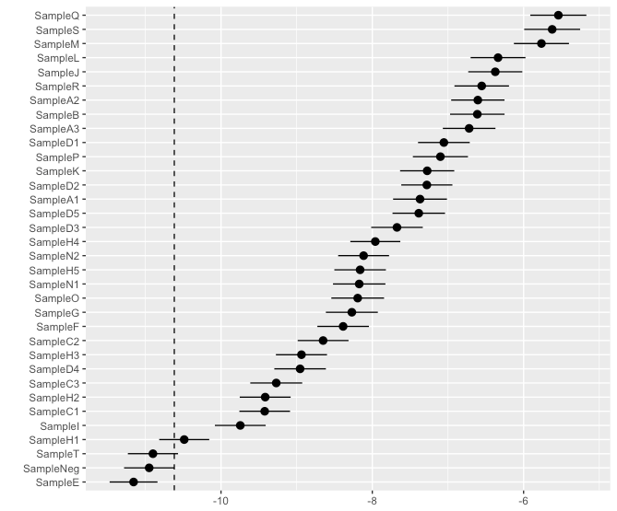
FIGURE 4
A)
Simulation Results
Network Structure (reminder)
A1: Approval diversity (race)
A2: Approval diversity (muslims)
A3: Approval diversity (immigrants)
B: Not too many immigrants
C1: Expecting environmental catastrophe
C2: Nature not strong enough to cope
C3: Humans insure earth remains fit
D1: Empathy with Europeans
D2: Empathy with humankind
D3: Empathy with countrymen
D4: Empathy with people in neighborhood
D5: Empathy with immigrants
E: No membership in social organizations
F: Not only one true religion
G: Non-religious politicians are not unfit
H1: No confidence in armed forces
H2: Confidence in the education systems
H3: Confidence in the police
H4: Confidence in the parliament
H5: Confidence in the government
I: Not strongly proud of the country
J: No job priority for people from the country
K: Approval of open borders
L: Immigrants are not a strain on welfare
M: Immigrants do not take jobs away
N1: Confidence in the EU
N2: Confidence in the UN
O: Supra-national social group identity
P: No ancestry based citizenship ideal
Q: Immigrants do not undermine cultural life
R: Immigrants to not increase crime rates
S: Immigrants will not be a threat to society
T: No fear of loss of culture through the EU
This can be covered and replaced with better labeling
Sth else?

Slide 10
Age
Living context
15.6
15.4
Sum scores and 95% confidence intervals
15.2
15.2
14.8
15.0
14.4
14.8
middle
old
young
rural
urban
Education
Immigration background
17.0
16.5
16.0
16.0
15.0
15.5
15.0
high
middle & low
no
yes

Slide 11
FIGURE 5
(a)
(b)
young
old
urban
rural
(c)
(d)
highly educated
middle high & low educated
immigration background
no immigration background

Slide 12
FIGURE 6

Slide 13
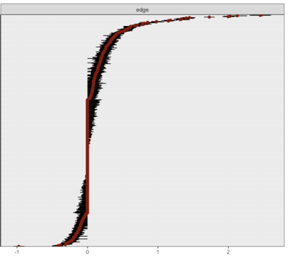
Edge
-1
0
1
2
Edge weight

Slide 15
Appendix 2

Slide 16
Appenidx 3
Result boot net analysis (edge stability)script 02_Main Network Analysis

Slide 17
Appendix 4
Result boot net analysis (centrality stability) script 02_Main Network Analysis

